Slide 1
Pothole Detection
Using Machine Learning
Viren Baria (9867144297)

Slide 2
Introduction
Pothole are one of the causes of traffic and road accidents.
The lack of concentration by the driver for fraction of time can cause an accident, if the driver fails to notice the pothole.
The potholes can be detected and reported to the concerned authority about its location.
Pothole Detection System built using Machine learning helps us to detect the potholes on the road.

Slide 3
DataSet
I have used a very small set of images (56) that I downloaded from Google.
I stored the downloaded images in two folders, “train”(40) and “test”(16).
Both these folders consist of images in labeled folder “Plain” and “Pothole”.

Slide 4
Image Preprocessing
The images from the train and test directories are imported using OpenCV library.
Further we performed the basic processing functions on the images.
Since the downloaded images were in different dimensions, they were resized into (256 * 256) pixels.

Slide 5
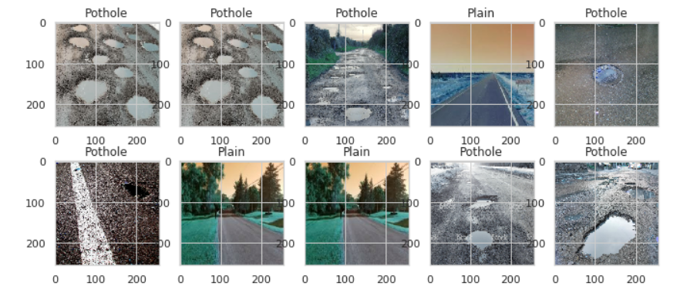
Labeling the data
The images(x) were assigned labels(y) for classification.
The images with potholes were labeled as “Pothole”.
The images without any potholes were labeled as “Plain”.

Slide 6
Train, Validation and Test Data
The training dataset is further divided into two sets, “train”(x_train, y_train) and “valid”(x_valid, y_valid).
The training data is randomly shuffled and splitted in the ratio (0.75:0.25).

Slide 7
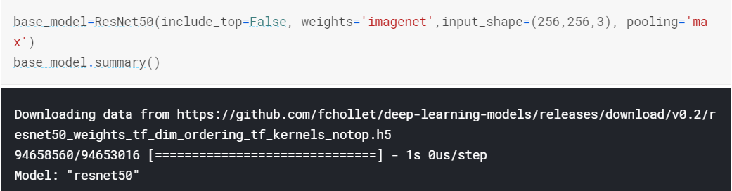
Training the Model
We used a pre-trained model on ImageNet dataset “ResNet”. The ResNet is used as base model.
ResNet acts as initial layer whose weights are saved and are available publicly. These pre-trained image models helps in reducing training time and improves accuracy.
Accuracy beyond human ability is obtained by learning images with 154 layers. Resnet achieved an error rate of 3.57% with the ImageNet test set and won the first place in ILSVRC 2015 classification task.
After using Resnet, we apply our normal CNN and fit the data.

Slide 8
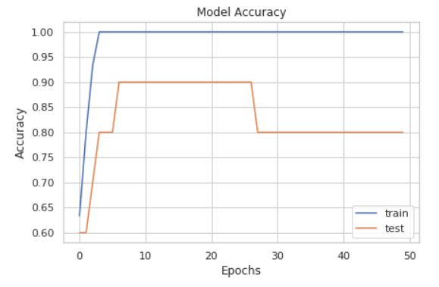
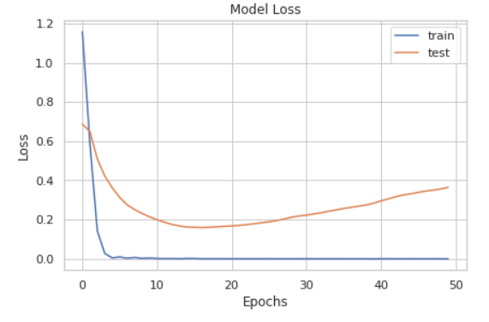
Performance of the Model
The trained model is save for future uses.
The accuracy and loss graphs of the training and validation data is plotted.

Slide 9
Testing the Model
The test folder consists of 16 images, 8 each with potholes(“Pothole”) and without potholes(“Plain”).
The trained model is applied on the test images to predict the outcome of the images.
If the image consists of potholes it is classified as “Pothole Road”.
If the image consists no potholes it is classified as “Plain Road”.

Slide 10
Results
All the roads with potholes are classified correctly.
Some images without potholes(plain road) are incorrectly classified as potholes road.
This occurs due to low training data, which can be overcame by using huge dataset.

Slide 11
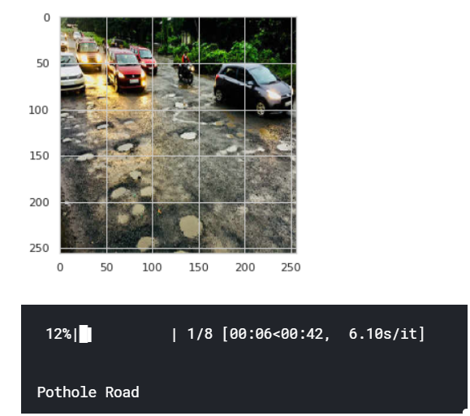
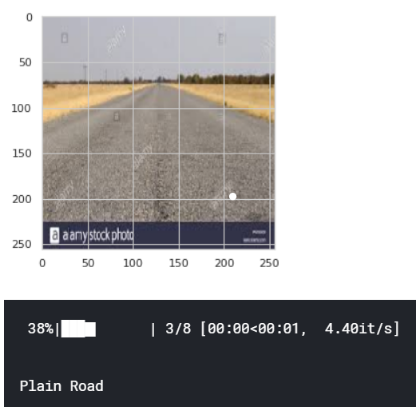
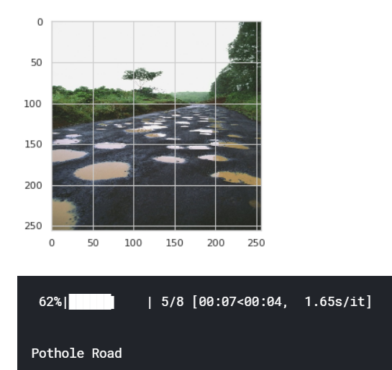
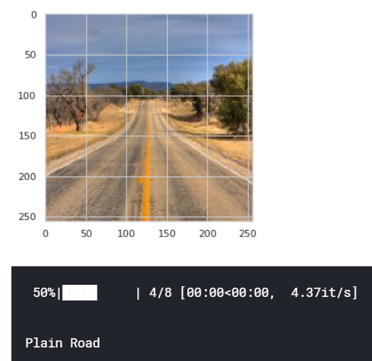
Correctly classified images
Pothole Road
Plain Road

Slide 12
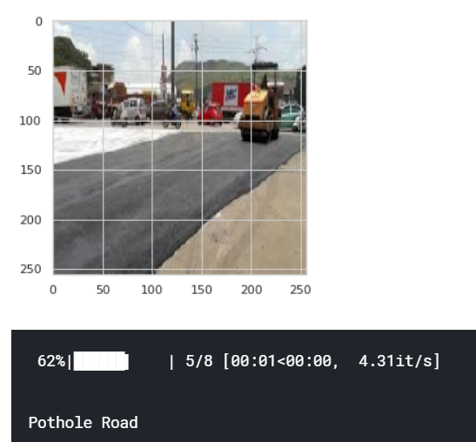
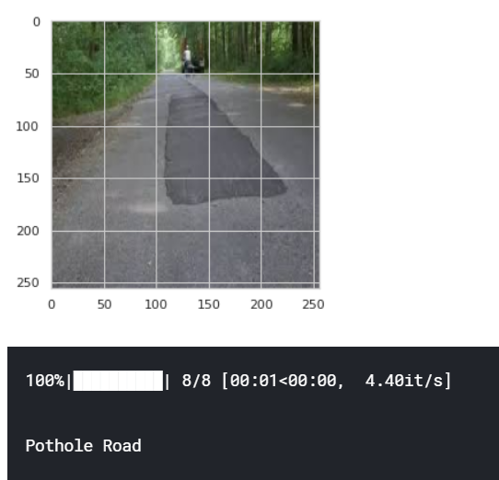
Incorrectly classified images

